Slide 1


Introduction to Software Engineering
BOOKEE
Group 14
Instructor: Nguyen Le Hoang Dung
Class: 21CLC03

Slide 2

MEMBER
21127115 - Tran Thanh Ngan
21127176 - Le Thi Hoai Thu
21127364 - Pham Thi Phuong Nam
21127412 - Ho Bach Nhu Quynh
21127476 - Le Nguyen Phuong Uyen

Slide 3


1
Problem statement,
2
Project Management
OUTLINE CONTENT
3
Software Requirements
4
Analysis & Design
5
Software testing

Slide 4

1. PROBLEM

Slide 5




PROBLEM

Slide 6


PRODUCT POSITION
The product name
That
For
Our Product
BOOKEE
Provides book in pdf form that you want
Every people from young to adult who want to read book
Help you find books easier and many features that support the purchase as well as online reading

Slide 7
2. PROJECT MANAGEMENT

Slide 8



TEAM STRUCTURE
Pham Thi Phuong Nam
Tran Thanh Ngan
Le Thi Hoai Thu
Ho Bach Nhu Quynh
Le Nguyen Phuong Uyen
Project manager, Back-end Developer
Business Analyst, Back-end Developer
Back-end Developer
Tester, Front-end Developer
Front-end Developer

Slide 9
Person | Role detail
Pham Thi Phuong Nam Project manager, Back - end developer | Project management / planning. Leading Architect in designing diagrams. Responsible for implementation of API and Database integration. Support other roles when needed
Tran Thanh Ngan Business analyst , Back - end developer | Write code
Le Thi Hoai Thu Back - end developer | Authentication, write code and verify the code works
Ho Bach Nhu Quynh Tester, Front - end developer | Responsible for implementation of UI Aid in evaluation of UI/UX Responsible for testing operations
Le Nguyen Phuong Uyen Front - end developer | Responsible for implementation of UI Aid in evaluation of UI/UX

Slide 10

SOFTWARE REQUIREMENT

Slide 11
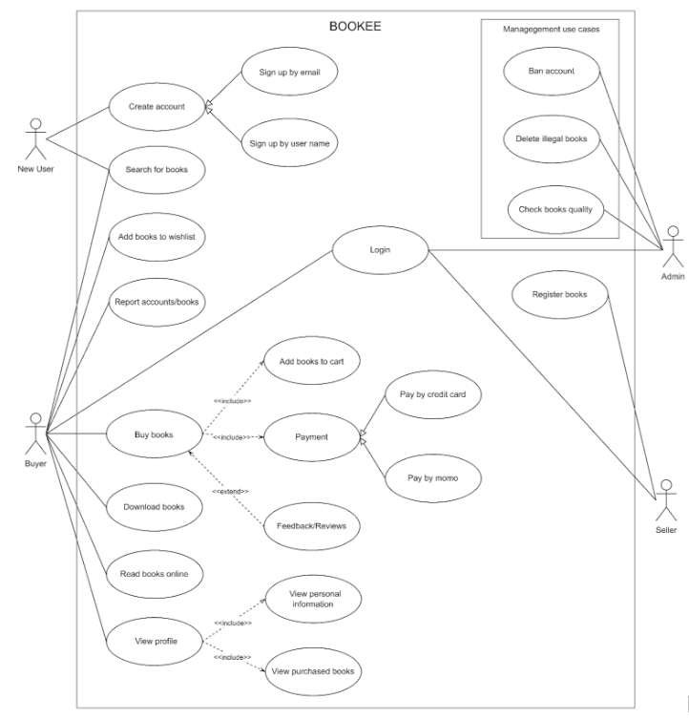
APPLICATION USECASE - MODEL

Slide 12

NON-FUNCTIONAL REQUIREMENTS
Efficiency
Reliability
UI/UX
Security

Slide 13

ANALYSE AND DESIGN

Slide 14
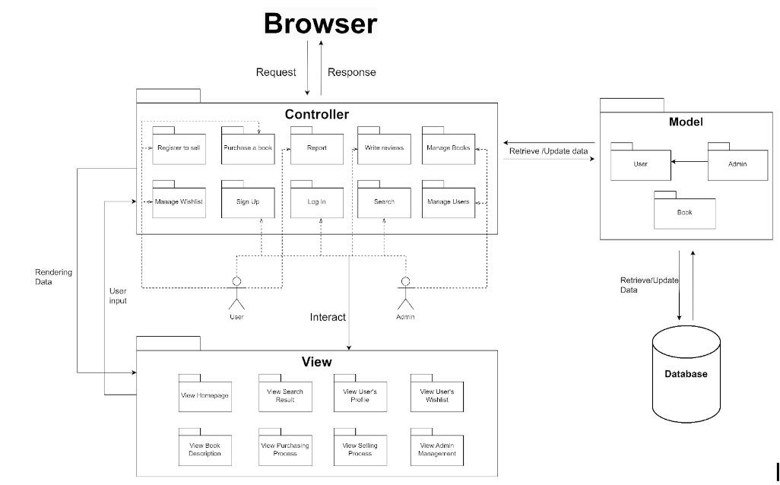
LOGICAL VIEW

Slide 15
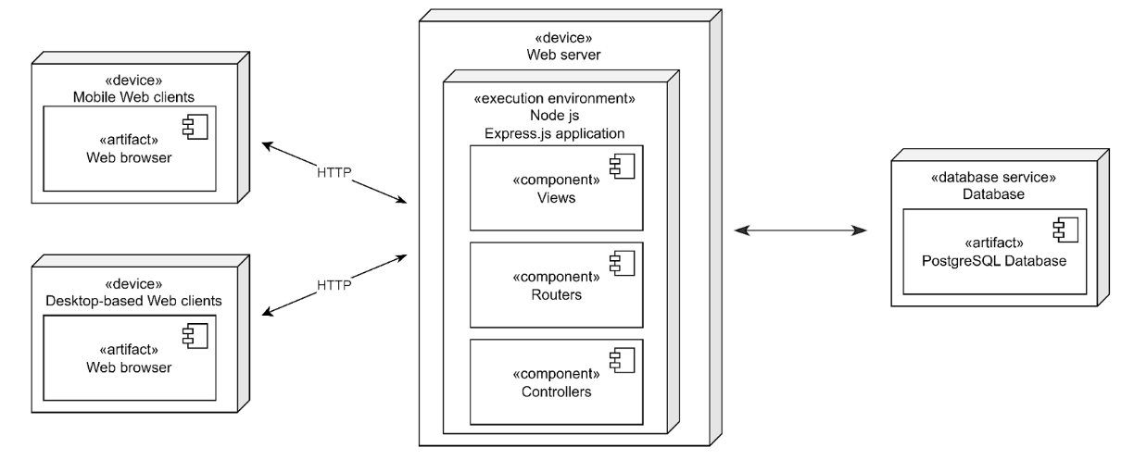
DETAILED ARCHITECTURE

Slide 16

SOFTWARE TESTING
TESTING ENVIRONMENT
SAMPLE TEST CASES

Slide 17
CHROME
Purpose: The environment to run the product (web), check compatibility
Version: 120.0.6099.130 (Official Build) (64-bit)
MICROSOFT EDGE
Purpose: The environment to run the product (web), check compatibility
Version: 120.0.2210.77
TESTING ENVIRONMENT
COC COC
Purpose: The environment to run the product (web), check compatibility
Version: 120.0.210

Slide 18

SAMPLE TESTCASE
UC01 | UI01 | Log in with correct Email address and password | 1. Enter Email address: "admin@gmail.com" 2.Enter Password: "1" 3. Click "Sign in" button | 1. Authenticated 2. The admin is redirect to homepage | 1. Authenticated 2. The screen move to homepage | Pass | HBNQuynh | 4/1/2024
UC03 | UI01 | Sign up with invalid email address | 1. Enter Username: "Jack" 2. Enter Email: "1234" 3. Enter Password: "1234" 4. Click "Sign up" button | 1. Unauthenticated 2. An invalid email notice will be displayed | 1. Unauthenticated 2. An invalid email notice will be displayed | Pass | HBNQuynh | 5/1/2024

Slide 19
SAMPLE TESTCASE
UC01 | UI05 | Login with spaces in the end of Email address | 1. Enter User Name: "user@gmail.com ". 2. Enter Password: "1" 3. Click "Sign in" button | 1. Unauthenticated 2. A wrong password notice will be displayed | 1. Unauthenticated 2. No notice is shown | Pass | HBNQuynh | 4/1/2024
UC03 | UI05 | Sign up with spaces in username | 1. Enter User name: "jack ma" 2. Enter Email: "1234@gmail.com. 3. Enter Password: "1234" 4. Click "Sign up" button | 1. Authenticate 2. The user is redirect to the login page | 1. Authenticate 2. The user is redirect to the login page | Pass | HBNQuynh | 5/1/2024

Slide 20
THANK YOU!
Visit us soon.

